Slide 1
Unit-2 Linear Regression

Slide 2
Regression analysis : An Overview
Regression analysis is a statistical method used in finance and investing. Regression analysis pools data together to help people and companies make informed decisions.
There are different variables at play in this type of statistical analysis, including a dependent variable—the main variable that you're trying to understand—and an independent variable(s)—factors that may have an impact on the dependent variable.
Linear regression (also called simple regression) is one of the most common techniques of regression analysis. linear regression only has one independent variable.
Multiple regression encompasses both linear and nonlinear regressions and incorporates multiple independent variables.
Each independent variable in multiple regression has its own coefficient to ensure each variable is weighted appropriately.

Slide 3
There are several main reasons people use regression analysis:
To predict future economic conditions, trends, or values.
To determine the relationship between two or more variables.
To understand how one variable changes when another changes.
While there are many different kinds of regression analysis, this concept will examine two different types: linear regression and multiple regression.
NOTE: A company can not only use regression analysis to understand certain situations, like why customer service calls are dropping, but also to make forward-looking predictions, like sales figures in the future.

Slide 4
Linear Regression
One of the most common machine learning and statistical methods is linear regression. At its most basic, it’s used when you want to express the mathematical relationship between two variables or attributes.
When you use it, you are making the assumption that there is a linear relationship between an outcome variable (sometimes also called the response variable, dependent variable, or label) and a predictor (sometimes also called an independent variable, explanatory variable, or feature);

Slide 5
Linear Regression
In some cases, it makes sense that changes in one variable correlate linearly with changes in another variable. For example, it makes sense that the more umbrellas you sell, the more money you make.
Why would you even want to build a linear model in the first place? You might want to use this relationship to predict future outcomes, or you might want to understand or describe the relationship to get a grasp on the situation.
Let’s say you’re studying the relationship between
A company’s sales and how much that company spends on advertising, or
The number of friends someone has on a social networking site and the time that person spends on that site daily.
These are all numerical outcomes, which mean linear regression would be a wise choice.

Slide 6
Example 1
Suppose you run a social networking site that charges a monthly subscription fee of $25. Each month you collect data and count your number of users and total revenue. You’ve done this daily over the course of two years, recording it all in a spreadsheet. You could express this data as a series of points.
Here are the first four:
S= (x, y) = {(1,25) , (10,250) , (100,2500) , (200,5000)}
One entry point for thinking about linear regression is we could describe a line with a slope and an intercept,
y = h (x) = β₀ +β₁ *x.
h(x_{i}) represents the predicted response value for ith observation.
β₀ and b β₁ are regression coefficients and represent y-intercept and slope of regression line respectively.

Slide 7
Example 1
y =25x. They likely could do this in their head, in which case
they figured out that:
• There’s a linear pattern.
• The coefficient relating x and y is 25.

Slide 8
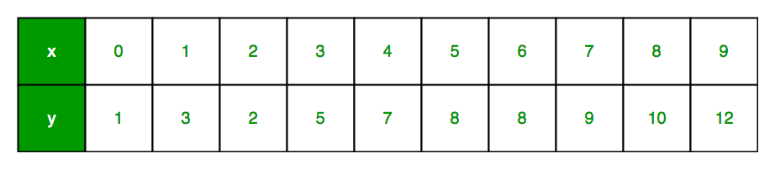
Example 2
Let us consider a dataset where we have a value of response y for every feature x:
For generality, we define:
x as feature vector, i.e x = [x_1, x_2, …., x_n],
y as response vector, i.e y = [y_1, y_2, …., y_n]

Slide 9
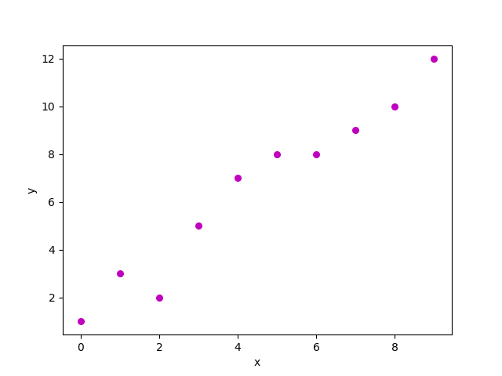
A scatter plot of above dataset looks like:
Now, the task is to find a line which fits best in above scatter plot so that we can predict the response for any new feature values. (i.e a value of x not present in dataset)
This line is called regression line.
To create our model, we must “learn” or estimate the values of regression coefficients.
And once we’ve estimated these coefficients, we can use the model to predict responses!

Slide 10
Slope for the Estimated Regression Equation
where:
x_{i} = value of independent variable for ith
observation
y_{i} = value of dependent variable for ith
observation
x^= mean value for independent variable
y^ = mean value for dependent variable

Slide 11
y-Intercept for the Estimated Regression Equation

Slide 12
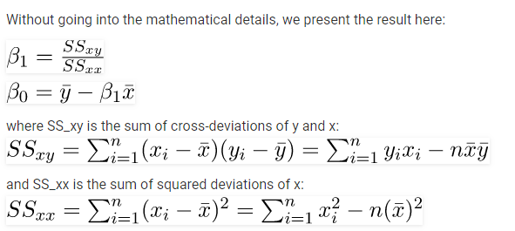
Estimating the Regression coefficients

Slide 13
In linear regression, every dependent value has a single corresponding independent variable that drives its value.
For example, in the linear regression formula of y = 3x + 7, there is only one possible outcome of "y" if "x" is defined as 2. Here y is the dependent variable and x is the independent variable.
Linear regression is graphically depicted using a straight line.
If the relationship between two variables does not follow a straight line, nonlinear regression may be used instead.
Linear regression Goal: The goal is to find the best-fitting line through the data points that minimizes the sum of the squared differences between the observed values and the values predicted by the line (this is known as the least squares method).

Slide 14
Linear Regression Algorithm involves formulating the model, estimating the parameters using methods like OLS, making predictions, and then evaluating the model.
Evaluation Metrics such as MAE, MSE, RMSE, R-squared, and Adjusted R-squared are used to measure how well the model performs and to assess the quality of predictions.

Slide 15

Estimate the Parameters:
Determine the values of the coefficients 𝛽 that minimize the difference between the predicted values and the actual values. This is typically done using the Ordinary Least Squares (OLS) method.
The OLS method minimizes the sum of squared residuals (the squared differences between observed and predicted values).Mathematically, you can use matrix notation to find the coefficients.
The equation for 𝛽 in matrix form is:

Slide 16

Predict:
Use the estimated parameters to predict the dependent variable YYY for new data points using the equation:

Slide 17
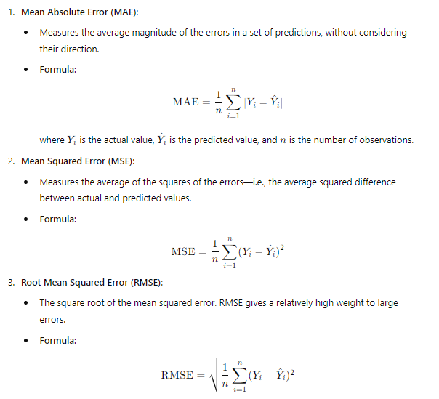
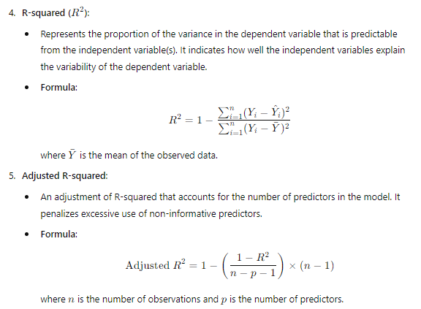
Linear Regression: Evaluation metrics To evaluate the performance of a linear regression model, you can use several metrics:

Slide 18
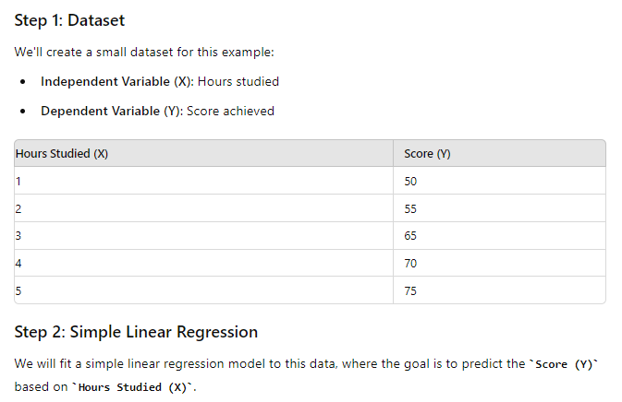
Complete example on Linear Regression
We will use Python to fit the model, make predictions, and calculate evaluation metrics.

Slide 19
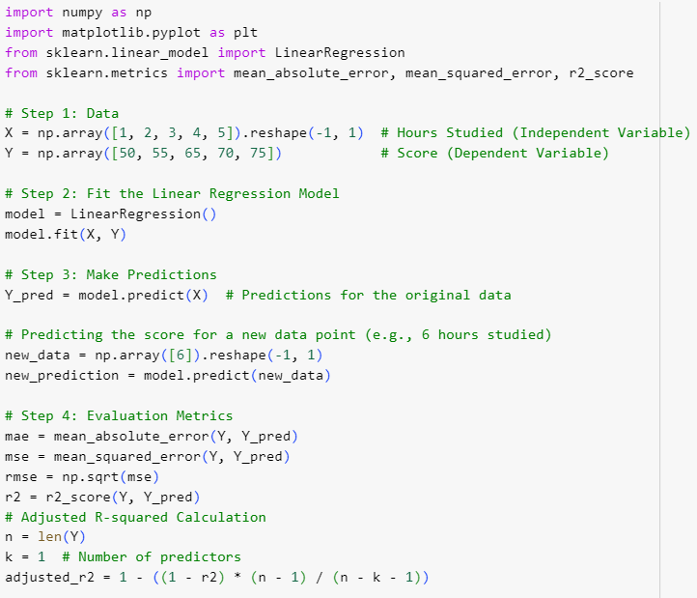
Linear Regression program for Hours studied vs score

Slide 20
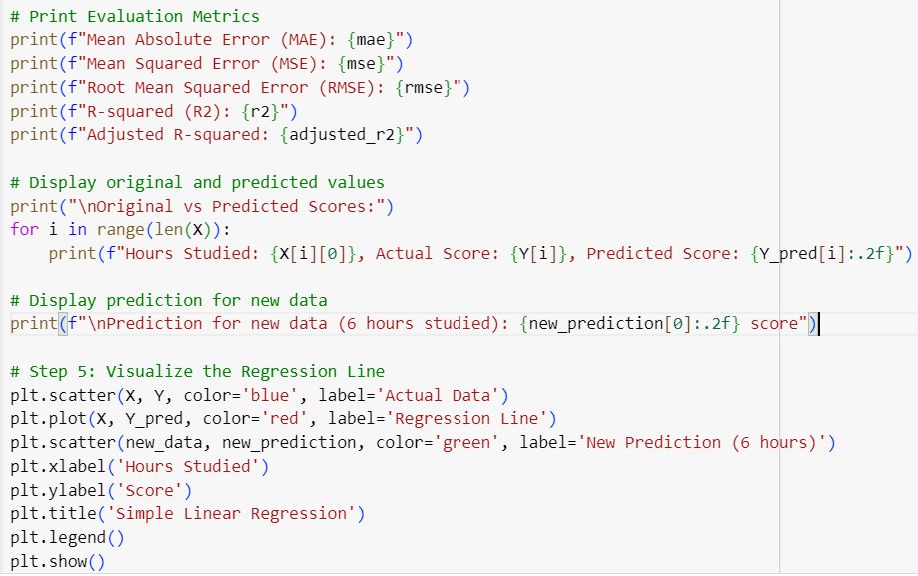

Slide 21
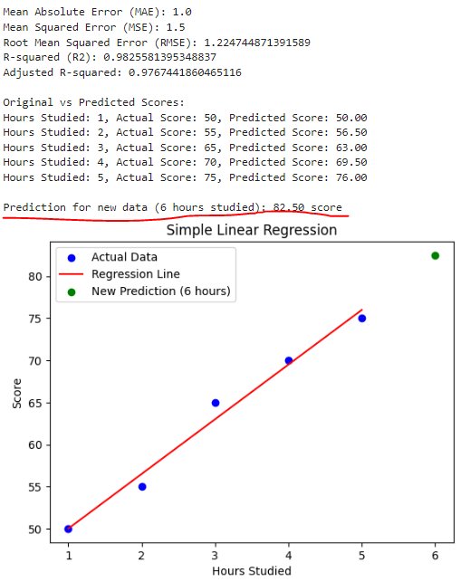
Output:

Slide 22
Output explanation for neat understanding purpose
1. Mean Absolute Error (MAE): 1.0
What It Means: On average, when the model predicts a student's score, it gets the score wrong by about 1 point.
Imagine This: If you were guessing the score someone would get based on how much they studied, on average, your guess would be just 1 point off from the actual score. For example, if the real score was 70, you might guess 69 or 71.
2. Mean Squared Error (MSE): 1.5
What It Means: MSE is a bit like MAE but with extra weight on bigger mistakes. If your guess is off by a lot, MSE makes it count more in the average. In this case, the squared error averages out to 1.5.
Imagine This: If most of your guesses are pretty close, but occasionally you're a bit further off, MSE makes those bigger mistakes stand out more. Here, even with those bigger mistakes, the average squared difference is still quite low at 1.5, which is good.

Slide 23
3. Root Mean Squared Error (RMSE): 1.22
What It Means: RMSE is just a fancy way to say that, on average, your predictions are about 1.22 points off from the real scores. It's similar to MAE but takes those bigger mistakes into account more strongly.
Imagine This: When you guess scores, you’re a little over 1 point off from the actual scores most of the time, which is pretty accurate.
4. R-squared (R²): 0.99
What It Means: R-squared tells us how well the number of hours studied explains the scores. An R-squared of 0.99 means that 99% of the differences in scores are explained by how many hours the students studied.
Imagine This: If you know how much someone studied, you can be 99% confident that you can predict their score accurately. It's like saying, "I almost completely understand how studying affects scores."

Slide 24
5.Adjusted R-squared
What It Means: Adjusted R-squared tells us how well the model explains the variation in the scores, but it also takes into account the number of predictors used in the model. This adjustment ensures that only useful predictors are considered when determining how well the model fits the data.
Imagine This: If you were guessing someone’s test score based on how long they studied, Adjusted R-squared would help you see if your guesses are accurate because of the study time or just by chance. It’s like making sure you're not just adding more guesses (predictors) to seem smart—only the ones that actually help should count. In this case, with just one predictor (hours studied), the Adjusted R-squared shows that your model is still highly effective, explaining about 98.75% of the score differences.

Slide 25
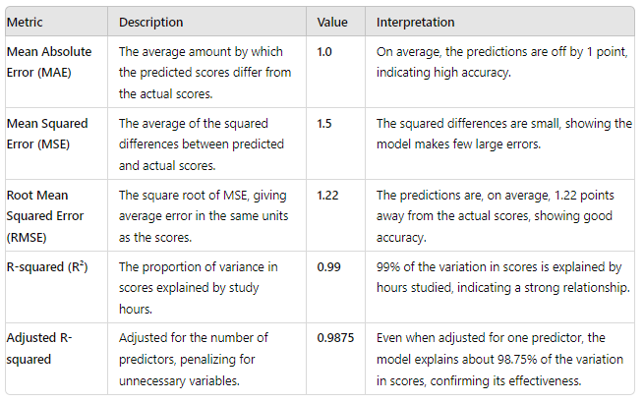
Summary Table of Evaluation Metrics for given example

Slide 26
Multiple Regression or Multivariate Regression
For complex connections between data, the relationship might be explained by more than one variable. In this case, an analyst uses multiple regression.
Multivariate Regression (often called Multiple Regression) is an extension of linear regression that involves multiple independent variables.
It models the relationship between one dependent variable and several independent variables. The general form of the equation is:
There are two main uses for multiple regression analysis.
The first is to determine the dependent variable based on multiple independent variables. For example, you may be interested in determining what a crop yield will be based on temperature, rainfall, and other independent variables.
The second is to determine how strong the relationship is between each variable. For example, you may be interested in knowing how a crop yield will change if rainfall increases—or the temperature decreases.

Slide 27
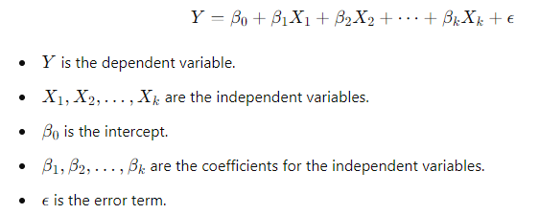
Multiple Regression models the relationship between one dependent variable and several independent variables. The general form of the equation is:
Goal: The aim is to determine the relationship between the dependent variable and the multiple independent variables, and to predict the dependent variable based on the values of the independent variables. The model seeks to find the best-fitting hyperplane (in a multidimensional space) that minimizes the sum of the squared differences between the observed and predicted values.
In summary:
Linear Regression typically refers to simple linear regression (one predictor).
Multivariate Regression refers to multiple regression (more than one predictor).

Slide 28
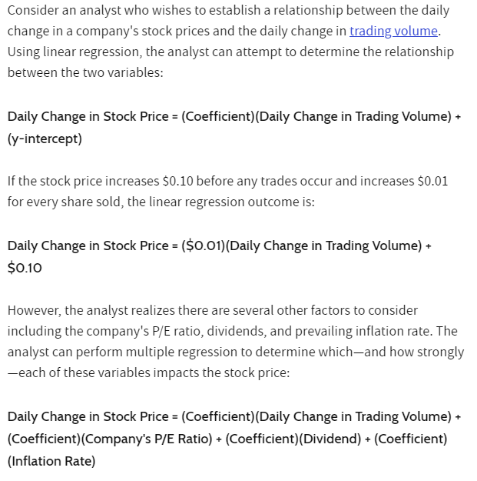
Linear Regression Vs Multiple Linear Regression

Slide 29
Multiple linear regression and simple linear regression both fall under the umbrella of linear regression models, and they share common evaluation metrics because the underlying principles of assessing model performance are similar.

Slide 30
Is Multiple Linear Regression Better Than Simple Linear Regression?
Multiple linear regression is a more specific calculation than simple linear regression.
For straight-forward relationships, simple linear regression may easily capture the relationship between the two variables.
For more complex relationships requiring more consideration, multiple linear regression is often better.
When Should You Use Multiple Linear Regression?
Multiple linear regression should be used when multiple independent variables determine the outcome of a single dependent variable. This is often the case when forecasting more complex relationships.
How Do You Interpret Multiple Regression?
A multiple regression formula has multiple slopes (one for each variable) and one y-intercept. It is interpreted the same as a simple linear regression formula—except there are multiple variables that all impact the slope of the relationship.

Slide 31
The Bottom Line
Regression analysis is a statistical method. There are many different types of regression analysis, including linear regression and multiple regression (among others).
Linear regression captures the relationship between two variables—for example, the relationship between the daily change in a company's stock prices and the daily change in trading volume.
Multiple linear regression is a more specific (and complex) calculation than simple linear regression. It incorporates multiple independent variables. For example, multiple regression could capture how the daily change in a company's stock price is impacted by the company's P/E ratio, dividends, the prevailing inflation rate, and the daily change in trading volume.

Slide 32
Example on Multiple Linear Regression: House price prediction
Let's go through example of multiple linear regression. we'll predict the house price based on three factors:
Size of the house (in square feet)
Number of bedrooms
Age of the house (in years)

Slide 33
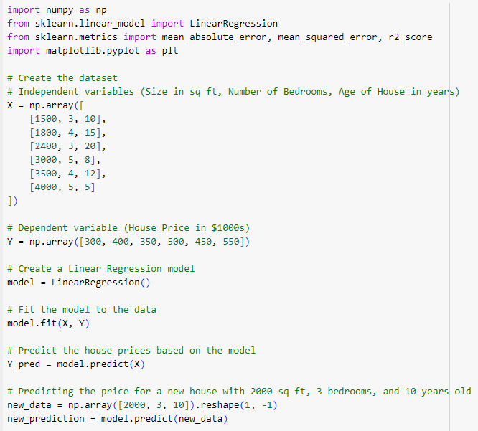
Example on Multiple Linear Regression: House price prediction

Slide 34
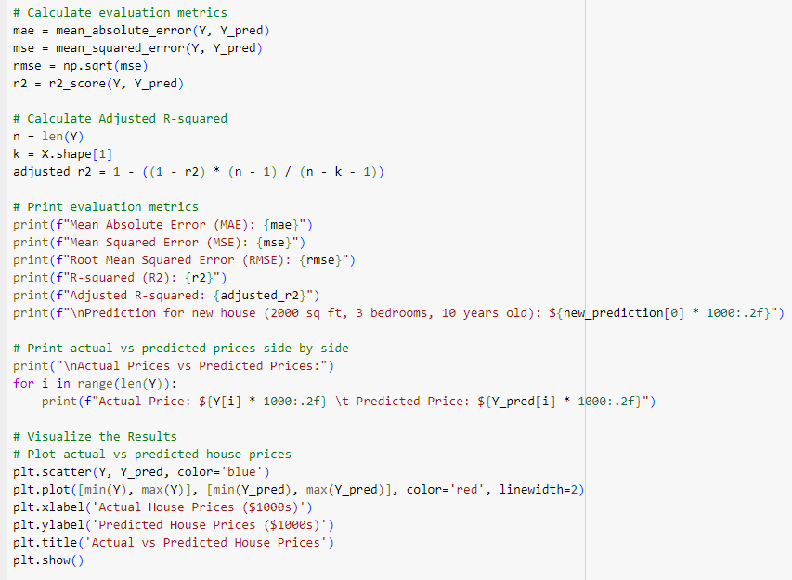

Slide 35
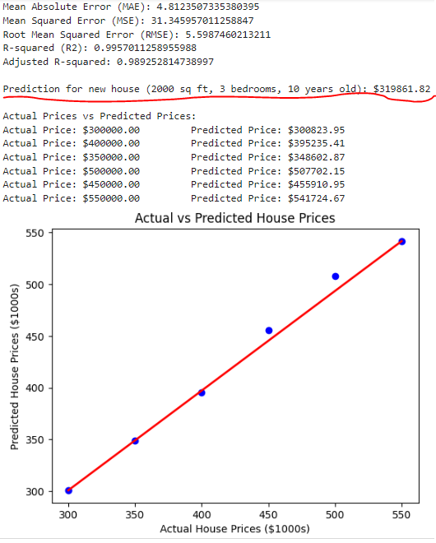
Output:

Slide 36
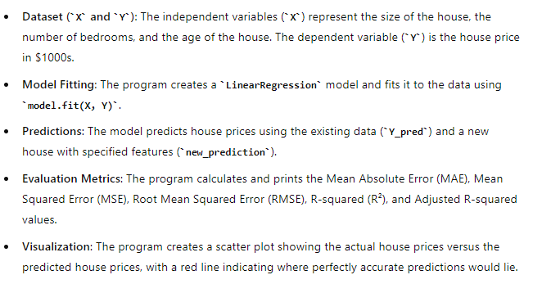
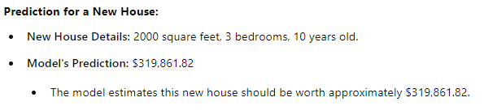
Explanation

Slide 37
